Slide 1

Mascot Private Meeting Scheduler
Jonathan Gold and Parsa Salimi

Slide 2
Outline
Motivate the topic
Introduction
Background information
Our function and Implementation
Security definition + analysis
Demo
Conclusion

Slide 3
Motivation
Why do we want a private scheduler?
Need to schedule a meeting -> Send someone calendar
Apps
Calandly
Doodle
When2Meet

Slide 4
Introduction
Goal: Find a meeting time, where each party does not have to reveal their schedule.
The function will output
Optimal meeting time
Amount of people able to attend the meeting
Whether or not each client acted honestly with inputs.

Slide 5
What does this look like for us?
n parties
Each party holds a where is the parties schedule represented as a binary vector
As a collective, the group wants to compute , where f computes the ideal meeting time

Slide 6
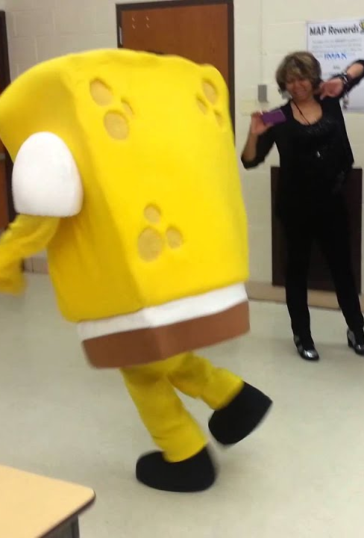
Mascot
What is Mascot? Secure MPC for dishonest majority.
Online phase exactly same as SPDZ
Better computational assumptions: DDH vs LWE.
Preprocessing: Instead of using SHE, uses oblivious transfer to compute multiplication triples.
Much faster!

Slide 7
MP-SPDZ implementation
What is MP-SPDZ?
Multi-Protocol SPDZ
Extends SPDZ-2 implementation to 34 MPC protocols
Consistent high level Python supported API
We leveraged their package for our implementation

Slide 8
Networking and Communication
Relies on P2P communication between all pairs of parties
Initial SPDZ assumed computing parties and clients were the same
In Confidential Benchmarking based on Multiparty Computation (Damsgard et al.) they separate client and server roles.
In the real world, we would have several servers running on different computers, and each client runs on a separate machine.
Issue : Servers can send modified shares to clients.
Solution: MPC provides representations of unknown random values, use these as authentication keys.

Slide 9
Our function – Base Mode
Goal: To calculate and reveal the time where the most number of people are free to meet
The function works as follows:
First, take in vectors from each of the participating clients
We calculate where
To find the best time we take (max number and max index)
Notes:
Should talk about how max is implemented

Slide 10
What is wrong with this?
Very easy to manipulate output
(Don’t send a binary vector)
Nothing is stopping a client from sending (for example) -
How do we stop a client from sending a nonbinary vector?

Slide 11
Our solution – Binary vector check
Options – Distributed Range proofs various versions
Prio
DIZK
ZPiE
Ignore range proofs
To perform a binary check on we run a comparison to see if each element is below 0 or greater than 1
This will be revealed alongside the output of the protocol, so users can determine trust in the results.

Slide 12
Douglas mode
What is Douglas mode?
What happens if one member must attend the meeting?
Simple solution:
First, take in vectors from each of the participating clients
We calculate where
Multiply by first
To find the best time we take (max number and max index)

Slide 13
Security Definition
The MASCOT protocol
secure against n-1 malicious parties.
Our protocol
must guarantee privacy of uncorrupted clients schedule.
we guarantee correctness of inputs.

Slide 14
Security analysis
MPC secures the process but not the output (Lindell)
We look at what is being leaked by the function
Security of Mascot guarantees security of the process

Slide 15
Function leakage
Recall that our function computes the max index, the value at this index, and the validity of each client’s input.
Problem with the previous version of our protocol: deterministic tiebreakers and trailing zeroes.
By introducing randomness, we can ensure that at most one index is leaked at each round.
We guarantee security only in single runs of the protocol.

Slide 16
Efficiency Discussion
 | 2 | 5 | 10 | 15 | 20
6 | 3.4 s | 5.8 s | 9.9 s | 13.9 s | 17.5 s
20 | 3 s | 5.9 s | 10.1 s | 14.1 s | 17.3 s
40 | 3.3 s | 5.5 s | 10.5s | 14.6 s | 16.3 s
80 | 3.9 s | 6 s | 9.8 s | 15.4 s | 16.9 s
160 | 3.3 s | 5.9 | 9.9s | 14.7 s | 17.1 s

Slide 17
How does this compare to MPC as studied in class?
Privacy
Statistical security against a Malicious active adversary corrupting up to n-1 parties
Correctness
Shown correct, guarantees clients input binary vector
Independence of inputs
No way to base inputs on others
Guaranteed output delivery
Not guaranteed
Fairness
Not guaranteed through distributed decryption

Slide 18
Conclusion
Explored MPC and MP-SPDZ
Implementation of private scheduling
Private scheduling demo
Security analysis
Efficiency.

Slide 19
Any Questions?

Slide 20
References
Damgård, I., Damgård, K., Nielsen, K., Nordholt, P. S., & Toft, T. (2017). Confidential benchmarking based on multiparty computation. Financial Cryptography and Data Security, 169–187. https://doi.org/10.1007/978-3-662-54970-4_10
Keller, M., Orsini, E., & Scholl, P. (2016). Mascot. Proceedings of the 2016 ACM SIGSAC Conference on Computer and Communications Security. https://doi.org/10.1145/2976749.2978357
Keller, M. (2020). MP-SPDZ: A versatile framework for multi-party computation. Proceedings of the 2020 ACM SIGSAC Conference on Computer and Communications Security. https://doi.org/10.1145/3372297.3417872

